Slide 1

DR. D. Y. PATIL SCHOOL OF SCIENCE & TECHNOLOGY
DR. D. Y. PATIL VIDYAPEETH (DPU), PIMPRI- PUNE
An Intelligent AI-Driven Framework for E-Commerce Customer Segmentation
Research Guide:
Mrs. Poi Tamrakar
Presented By:
Student Name: Abhinav Masih - 01
Anaisha bulchandani – 07
Sanchay Bathe – 14
Soumya Tiwari – 53
Branch: AI&DS
Semester: V

Slide 2
Outline
Introduction
Motivation
Problem Statement
Problem Objectives
Literature Review
Research Gaps
Dataset
Methodology
UML Diagrams
Algorithm
Code & Output
Results
Reference

Slide 3
Introduction
E-commerce has transformed how customers purchase products and interact with businesses. Every online transaction generates valuable data, including purchase frequency, spending patterns, order history, and time between purchases. However, this large volume of data can be difficult to interpret and does not clearly reveal different customer types.
Customer segmentation helps businesses divide customers into meaningful groups based on similarities in purchasing behaviour. This enables businesses to identify high-value, regular, and inactive customers and develop more targeted strategies.
Traditional segmentation often relies on manually defined rules or basic statistical techniques. With increasing customer data, Machine Learning provides a systematic and data-driven approach to identifying behavioural patterns.
This project focuses on developing an E-Commerce Customer Segmentation using real-world online retail transaction data to generate meaningful customer insights and support data-driven decision-making.

Slide 4
Motivation
Most existing studies use RFM with traditional clustering methods like K-Means for customer segmentation. [3], [5], [6], [10], [11]
Deep Learning has shown potential to learn better representations for clustering. [1], [2]
Deep representations can help handle complex and high-dimensional customer information. [8]
Deep Embedded Clustering has shown better clustering performance than K-Means in comparative research. [11]
Combining additional behavioural features with Deep Learning can improve customer segmentation. [12]

Slide 5
Problem Statement
To design, develop, and evaluate an intelligent e-commerce customer analytics system that analyzes transaction data to identify meaningful customer segments based on purchasing behaviour, utilizes deep learning-based representations to improve customer profiling and segmentation and presents actionable customer insights through an interactive analytics dashboard.

Slide 6
Problem Objectives
Aim: “To develop an intelligent customer segmentation that uses machine learning and Deep Learning techniques to understand customer behaviour, identify distinct customer groups, and support data-driven e-commerce decision-making.”
Objectives:
To collect, preprocess, and analyze e-commerce customer transaction data to identify relevant customer attributes, purchasing patterns, and behavioral features for customer analytics.
To design and develop an AI-based customer segmentation model using suitable clustering techniques and deep learning-based representations to group customers according to their purchasing behavior.
To evaluate the developed clustering and deep learning models using appropriate performance metrics, and build an interactive prototype dashboard to visualize customer segments, purchasing patterns, and model outputs.

Slide 7
LITERATURE REVIEW
Table I – Traditional Segmentation and Deep Learning Foundations
Early studies focused on RFM and traditional clustering methods for customer segmentation.
[1] and [2] introduced Deep Learning-based clustering and showed that neural networks can learn meaningful data representations for clustering.
[3], [4] and [5] mainly focused on improving traditional RFM-based segmentation and clustering methods.
Table II – ML-Based Customer Analysis and Advanced Segmentation
[6] and [9] continued using RFM with K-Means for customer segmentation, while [7] integrated RFM with association rules and machine learning.
[8] showed that Deep Learning and semantic representations can improve segmentation for complex customer information.
Table III – Recent Deep Learning and Behavioural Approaches
[10] applied data preprocessing, RFM and K-Means to the UCI Online Retail II dataset.
[11] compared Deep Embedded Clustering with K-Means and reported better clustering evaluation results for DEC.
[12] extended RFM with additional behavioural features and combined them with Deep Learning for segmentation.

Slide 8
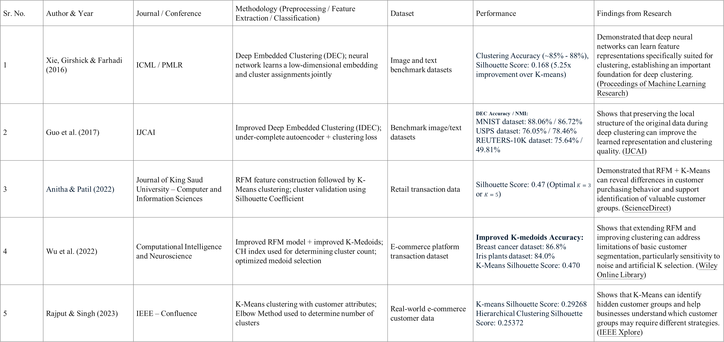
Literature Review Table- I
Sr. No. | Author & Year | Journal / Conference | Methodology (Preprocessing / Feature Extraction / Classification) | Dataset | Performance | Findings from Research
1 | Xie, Girshick & Farhadi (2016) | ICML / PMLR | Deep Embedded Clustering (DEC); neural network learns a low-dimensional embedding and cluster assignments jointly | Image and text benchmark datasets | Clustering Accuracy (~85% - 88%), Silhouette Score: 0.168 (5.25x improvement over K-means) | Demonstrated that deep neural networks can learn feature representations specifically suited for clustering, establishing an important foundation for deep clustering. (Proceedings of Machine Learning Research)
2 | Guo et al. (2017) | IJCAI | Improved Deep Embedded Clustering (IDEC); under-complete autoencoder + clustering loss | Benchmark image/text datasets | DEC Accuracy / NMI: MNIST dataset: 88.06% / 86.72% USPS dataset: 76.05% / 78.46% REUTERS-10K dataset: 75.64% / 49.81% | Shows that preserving the local structure of the original data during deep clustering can improve the learned representation and clustering quality. (IJCAI)
3 | Anitha & Patil (2022) | Journal of King Saud University – Computer and Information Sciences | RFM feature construction followed by K-Means clustering; cluster validation using Silhouette Coefficient | Retail transaction data | Silhouette Score: 0.47 (Optimal $K=3$ or $K=5$) | Demonstrated that RFM + K-Means can reveal differences in customer purchasing behavior and support identification of valuable customer groups. (ScienceDirect)
4 | Wu et al. (2022) | Computational Intelligence and Neuroscience | Improved RFM model + improved K-Medoids; CH index used for determining cluster count; optimized medoid selection | E-commerce platform transaction dataset | Improved K-medoids Accuracy: Breast cancer dataset: 86.8% Iris plants dataset: 84.0% K-Means Silhouette Score: 0.470 | Shows that extending RFM and improving clustering can address limitations of basic customer segmentation, particularly sensitivity to noise and artificial K selection. (Wiley Online Library)
5 | Rajput & Singh (2023) | IEEE – Confluence | K-Means clustering with customer attributes; Elbow Method used to determine number of clusters | Real-world e-commerce customer data | K-means Silhouette Score: 0.29268 Hierarchical Clustering Silhouette Score: 0.25372 | Shows that K-Means can identify hidden customer groups and help businesses understand which customer groups may require different strategies. (IEEE Xplore)

Slide 9
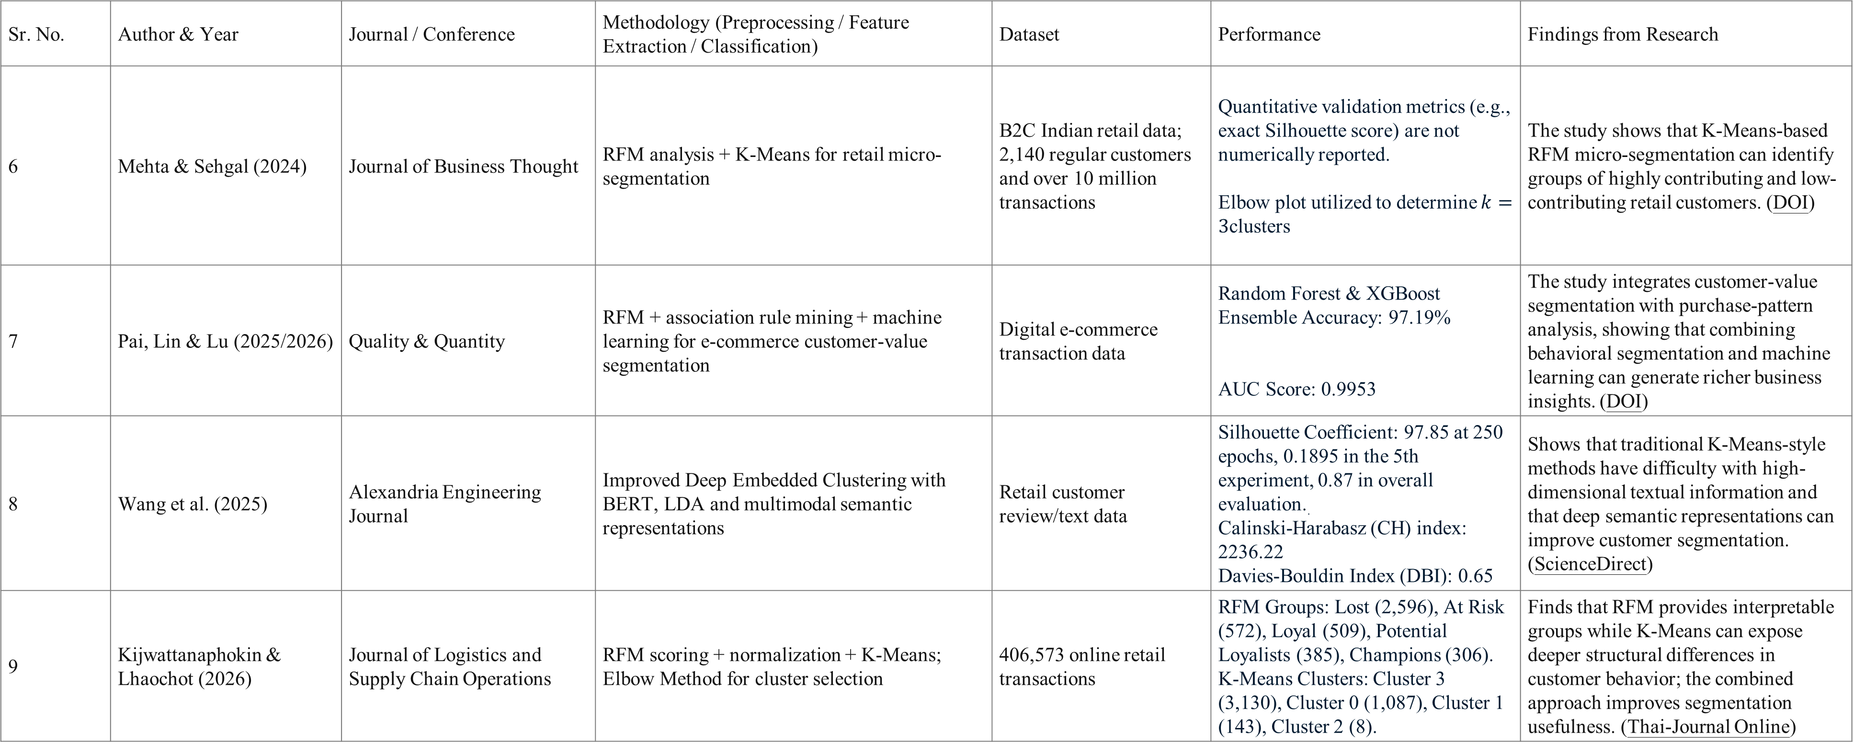
Literature Review Table- II
Sr. No. | Author & Year | Journal / Conference | Methodology (Preprocessing / Feature Extraction / Classification) | Dataset | Performance | Findings from Research
6 | Mehta & Sehgal (2024) | Journal of Business Thought | RFM analysis + K-Means for retail micro-segmentation | B2C Indian retail data; 2,140 regular customers and over 10 million transactions | Quantitative validation metrics (e.g., exact Silhouette score) are not numerically reported. Elbow plot utilized to determine $k=3$clusters | The study shows that K-Means-based RFM micro-segmentation can identify groups of highly contributing and low-contributing retail customers. (DOI)
7 | Pai, Lin & Lu (2025/2026) | Quality & Quantity | RFM + association rule mining + machine learning for e-commerce customer-value segmentation | Digital e-commerce transaction data | Random Forest & XGBoost Ensemble Accuracy: 97.19% AUC Score: 0.9953 | The study integrates customer-value segmentation with purchase-pattern analysis, showing that combining behavioral segmentation and machine learning can generate richer business insights. (DOI)
8 | Wang et al. (2025) | Alexandria Engineering Journal | Improved Deep Embedded Clustering with BERT, LDA and multimodal semantic representations | Retail customer review/text data | Silhouette Coefficient: 97.85 at 250 epochs, 0.1895 in the 5th experiment, 0.87 in overall evaluation.. Calinski-Harabasz (CH) index: 2236.22 Davies-Bouldin Index (DBI): 0.65 | Shows that traditional K-Means-style methods have difficulty with high-dimensional textual information and that deep semantic representations can improve customer segmentation. (ScienceDirect)
9 | Kijwattanaphokin & Lhaochot (2026) | Journal of Logistics and Supply Chain Operations | RFM scoring + normalization + K-Means; Elbow Method for cluster selection | 406,573 online retail transactions | RFM Groups: Lost (2,596), At Risk (572), Loyal (509), Potential Loyalists (385), Champions (306). K-Means Clusters: Cluster 3 (3,130), Cluster 0 (1,087), Cluster 1 (143), Cluster 2 (8). | Finds that RFM provides interpretable groups while K-Means can expose deeper structural differences in customer behavior; the combined approach improves segmentation usefulness. (Thai-Journal Online)

Slide 10
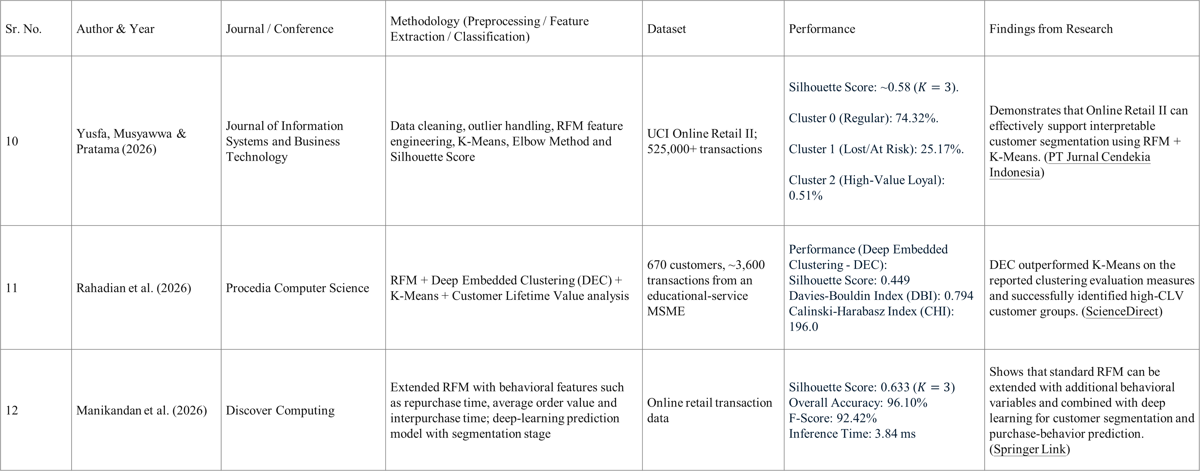
Literature Review Table- III
Sr. No. | Author & Year | Journal / Conference | Methodology (Preprocessing / Feature Extraction / Classification) | Dataset | Performance | Findings from Research
10 | Yusfa, Musyawwa & Pratama (2026) | Journal of Information Systems and Business Technology | Data cleaning, outlier handling, RFM feature engineering, K-Means, Elbow Method and Silhouette Score | UCI Online Retail II; 525,000+ transactions | Silhouette Score: ~0.58 ($K=3$). Cluster 0 (Regular): 74.32%. Cluster 1 (Lost/At Risk): 25.17%. Cluster 2 (High-Value Loyal): 0.51% | Demonstrates that Online Retail II can effectively support interpretable customer segmentation using RFM + K-Means. (PT Jurnal Cendekia Indonesia)
11 | Rahadian et al. (2026) | Procedia Computer Science | RFM + Deep Embedded Clustering (DEC) + K-Means + Customer Lifetime Value analysis | 670 customers, ~3,600 transactions from an educational-service MSME | Performance (Deep Embedded Clustering - DEC): Silhouette Score: 0.449 Davies-Bouldin Index (DBI): 0.794 Calinski-Harabasz Index (CHI): 196.0 | DEC outperformed K-Means on the reported clustering evaluation measures and successfully identified high-CLV customer groups. (ScienceDirect)
12 | Manikandan et al. (2026) | Discover Computing | Extended RFM with behavioral features such as repurchase time, average order value and interpurchase time; deep-learning prediction model with segmentation stage | Online retail transaction data | Silhouette Score: 0.633 ($K=3$) Overall Accuracy: 96.10% F-Score: 92.42% Inference Time: 3.84 ms | Shows that standard RFM can be extended with additional behavioral variables and combined with deep learning for customer segmentation and purchase-behavior prediction. (Springer Link)

Slide 11
Key Findings from Literature Review
1. RFM is widely used for customer segmentation
RFM effectively captures recency, purchase frequency and customer spending, but most studies combine it with traditional clustering methods such as K-Means. [3], [4],[5], [6], [9], [10]
2. Deep Learning provides richer customer representations
Studies on DEC, IDEC and deep semantic representations show that Deep Learning can learn complex patterns that may not be captured by directly using the original features. [1], [2], [8]
3. Deep Learning shows potential over traditional clustering
The study in [11] reported better clustering evaluation results for DEC compared with K-Means, supporting the use of more advanced Deep Learning-based approaches.
4. Behavioural features can improve customer profiling
Research shows that extending basic RFM with features such as average order value, repurchase time and interpurchase time provides a richer view of customer behaviour. [12]

Slide 12
Research Gaps
Limited Use of Deep Learning
Most studies rely on RFM with traditional K-Means, with limited use of Deep Learning for learning customer representations. [3], [4], [5], [6], [9], [10]
2. Limited Behavioral Features
Several studies mainly use basic RFM, while additional behavioral features can provide a deeper understanding of customer purchasing patterns. [3], [4], [5], [6], [9], [10]
3. Static Feature Representations
Existing studies rely heavily on basic statistical metrics without fully leveraging deep representation models for high-dimensional customer segmentation. [3], [4], [5], [6], [9], [10]
4. Need for Practical Implementation
Many studies focus on model development and evaluation, with limited emphasis on an interactive system for practical customer analysis. [3], [5], [6], [7], [9], [10]

Slide 13
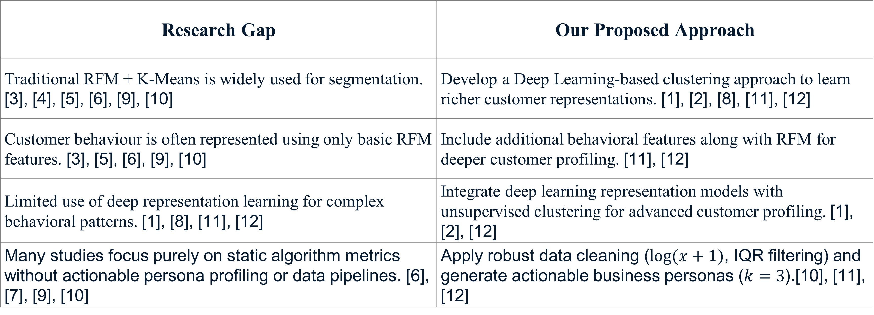
Research Gap → Proposed Contribution
Research Gap | Our Proposed Approach
Traditional RFM + K-Means is widely used for segmentation. [3], [4], [5], [6], [9], [10] | Develop a Deep Learning-based clustering approach to learn richer customer representations. [1], [2], [8], [11], [12]
Customer behaviour is often represented using only basic RFM features. [3], [5], [6], [9], [10] | Include additional behavioral features along with RFM for deeper customer profiling. [11], [12]
Limited use of deep representation learning for complex behavioral patterns. [1], [8], [11], [12] | Integrate deep learning representation models with unsupervised clustering for advanced customer profiling. [1], [2], [12]
Many studies focus purely on static algorithm metrics without actionable persona profiling or data pipelines. [6], [7], [9], [10] | Apply robust data cleaning ($log⁡(x+1)$, IQR filtering) and generate actionable business personas ($k=3$).[10], [11], [12]

Slide 14
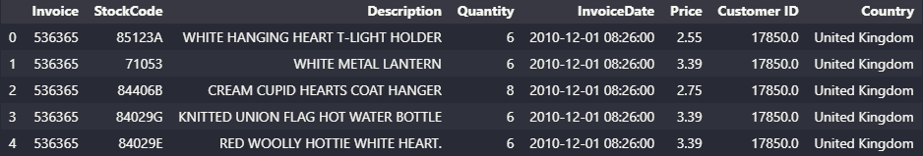
Dataset
UCI Online Retail II: https://www.kaggle.com/datasets/mashlyn/online-retail-ii-uci
Data Source & Scope:
  This Online Retail II data set contains all the transactions occurring for a UK-based and registered, non-store online retail between December 2009 and December 2011 .The company mainly sells unique all-occasion gift-ware. Many customers of the company are wholesalers.
Raw Feature Schema:
  InvoiceNo: 6-digit transaction ID (prefixed with 'C' for cancellation entries).
  StockCode & Description: Product SKU identifier and item description.
  Quantity & UnitPrice: Units purchased per item and unit price in GBP (£).
  InvoiceDate: Timestamp of order placement.
  CustomerID: Unique 5-digit identifier for registered customers.
  Country: Geographical location of the buyer (predominantly United Kingdom).

Slide 15
Dataset
Dataset Characteristics, Quality & Processing Pipeline
Data Scale & Volume Progression:
  Raw Records: 541,910 transactional logs.
  Cleaned Records: 396,470 valid purchase entries after dropping missing CustomerIDs, cancellations, and administrative codes.
Key Data Characteristics & Challenges:
Uneven Sales: Most of our sales come from just a few big spenders, not from everyone buying a little bit.
Two Types of Buyers: We have two distinct groups: people who shop once for themselves and businesses that buy in bulk frequently.
Messy Data: Many transactions lack customer IDs because they are anonymous, and some purchase amounts are unusually high or low compared to typical

Slide 16
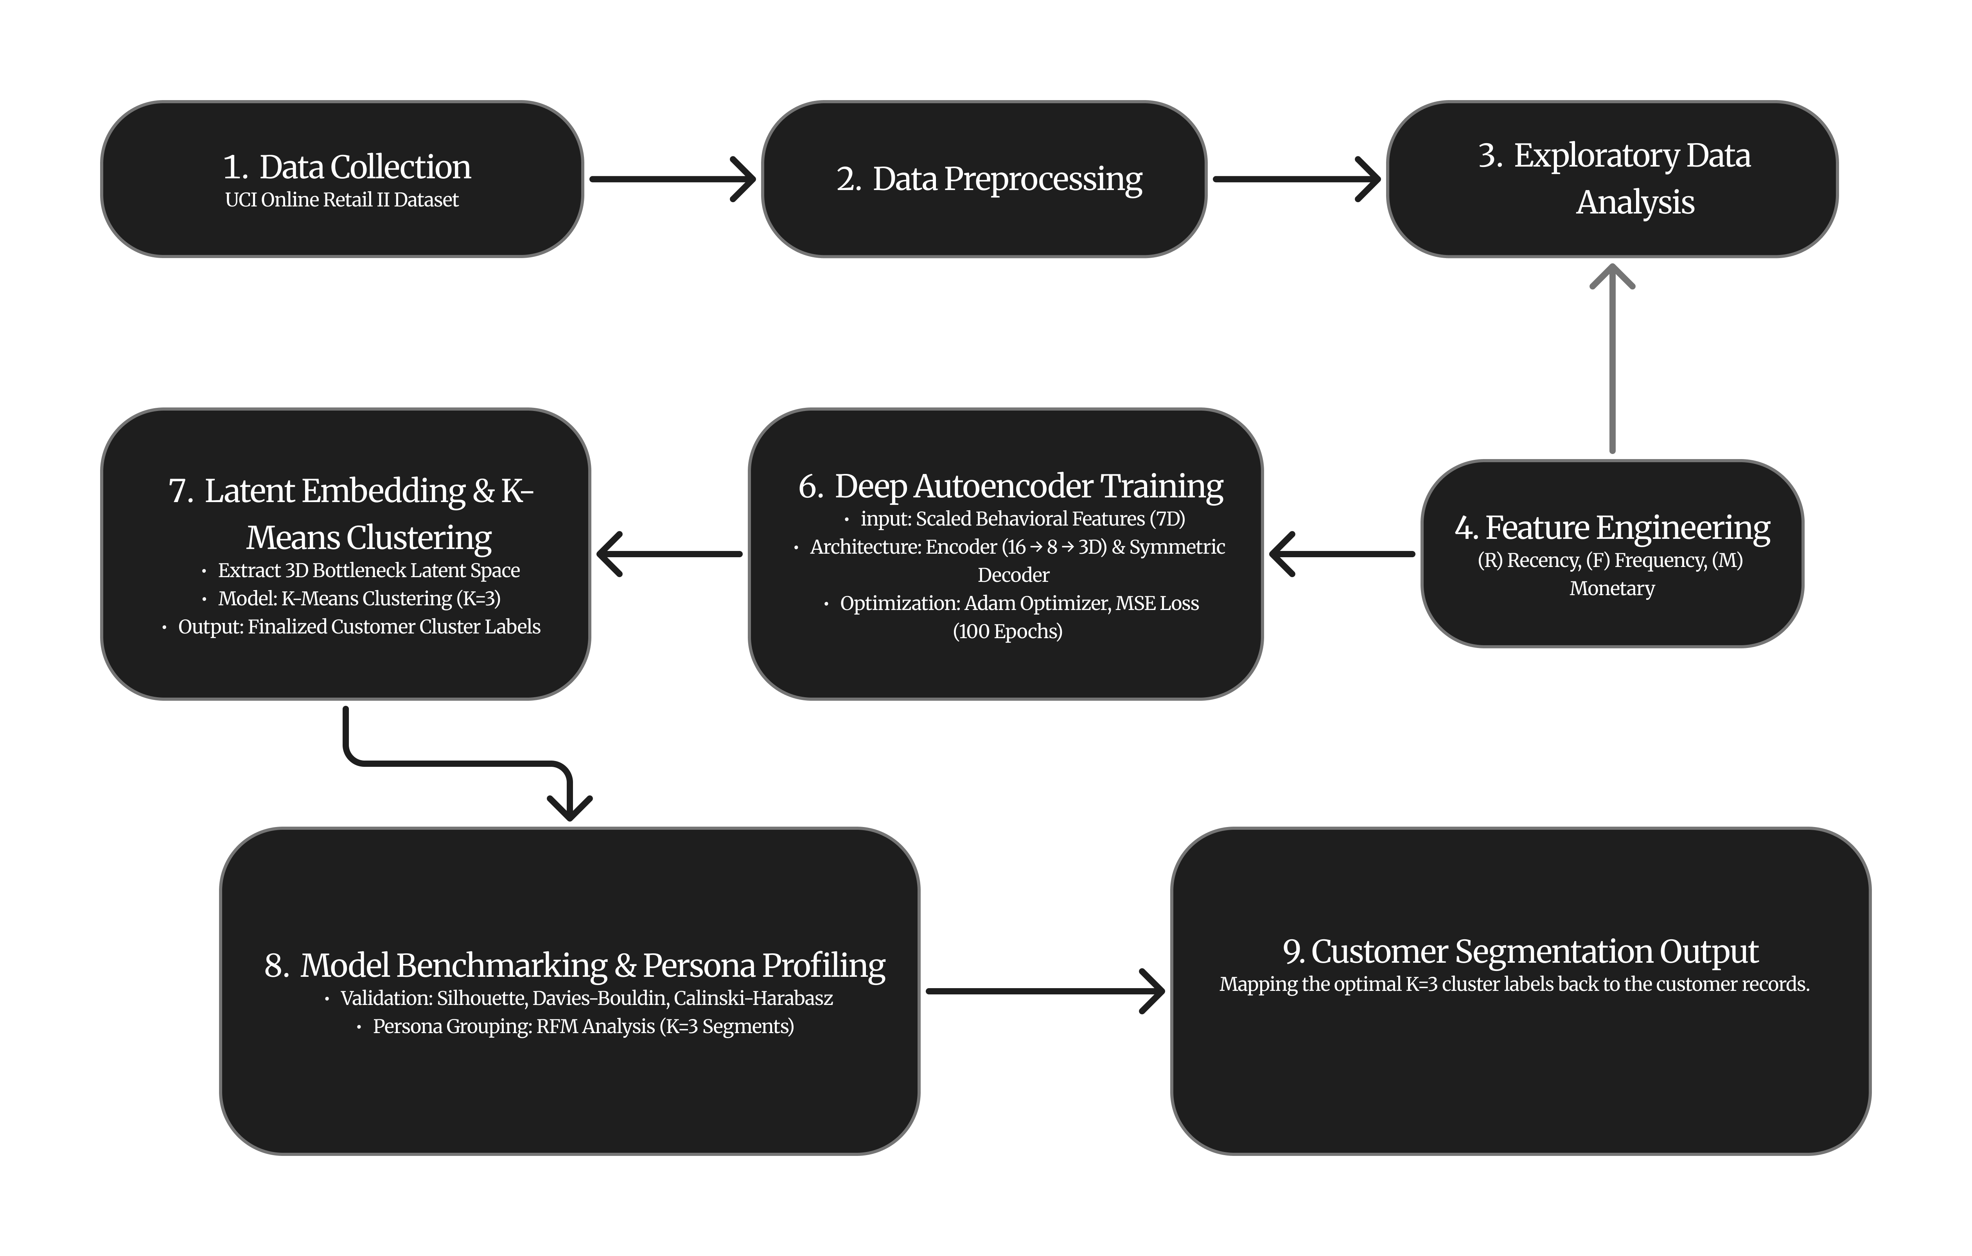
Methodology

Slide 17
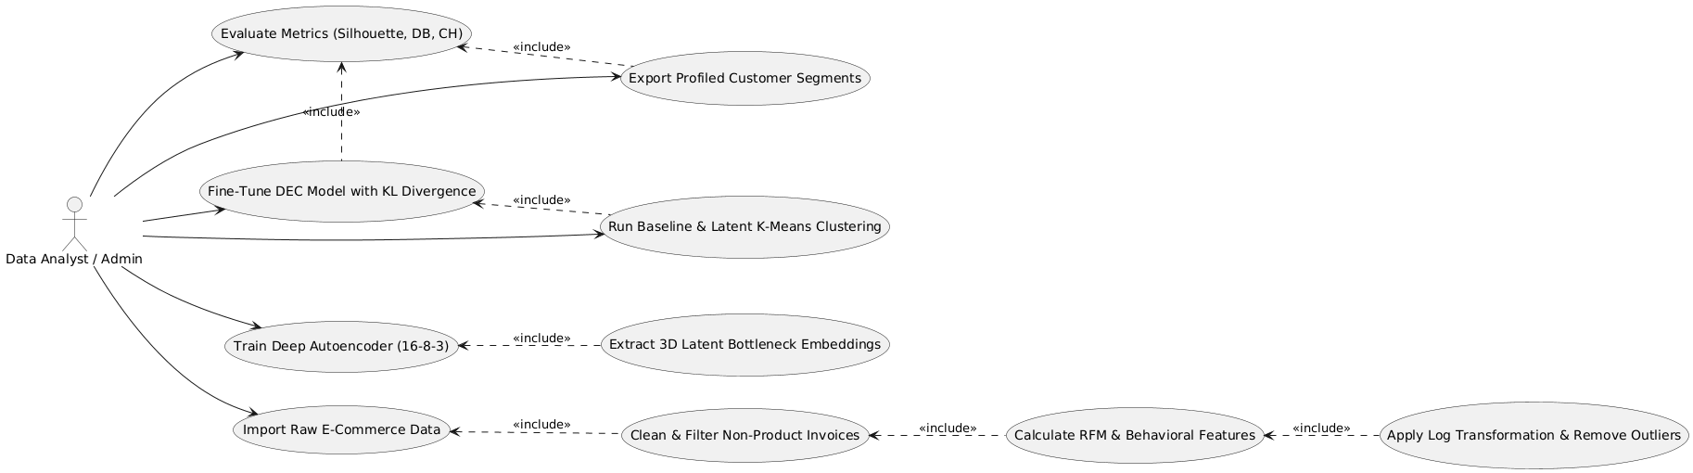
Use Case diagram

Slide 18
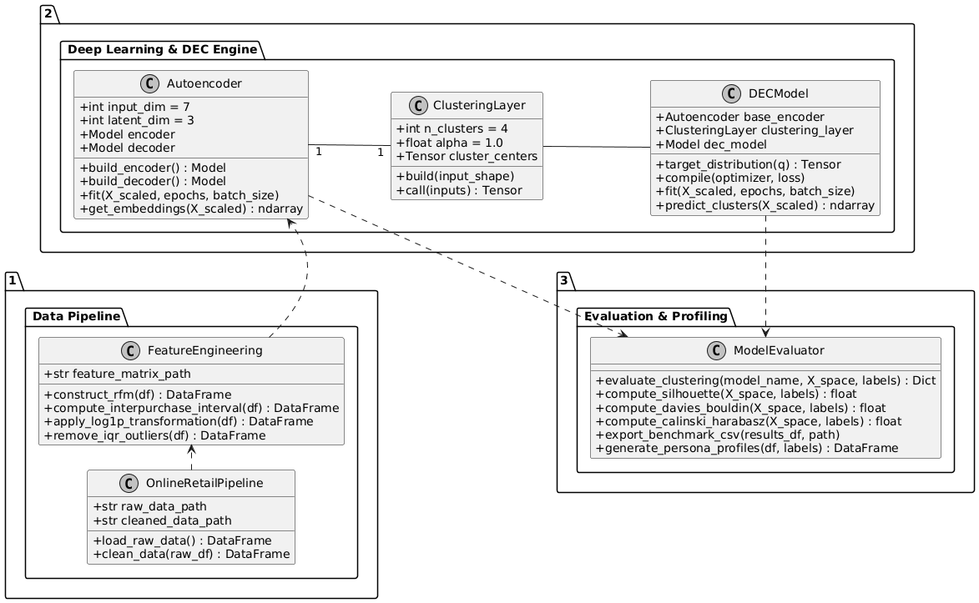
Class Diagram

Slide 19
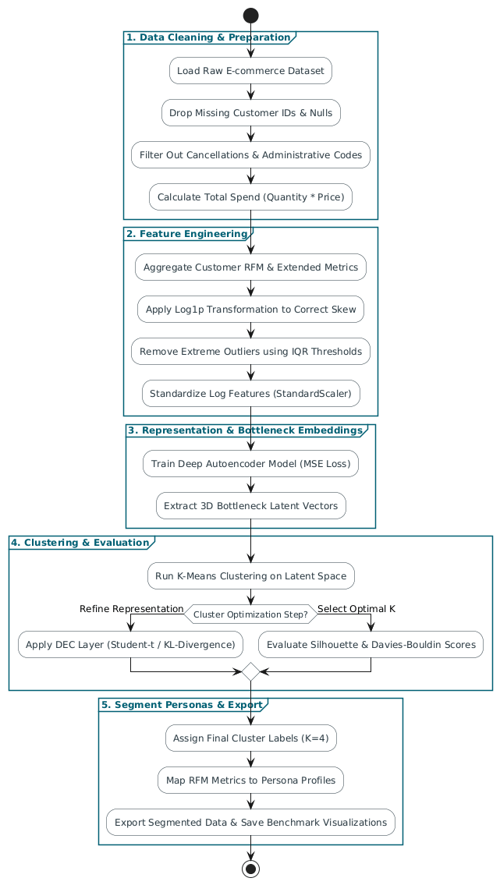
Activity diagram

Slide 20
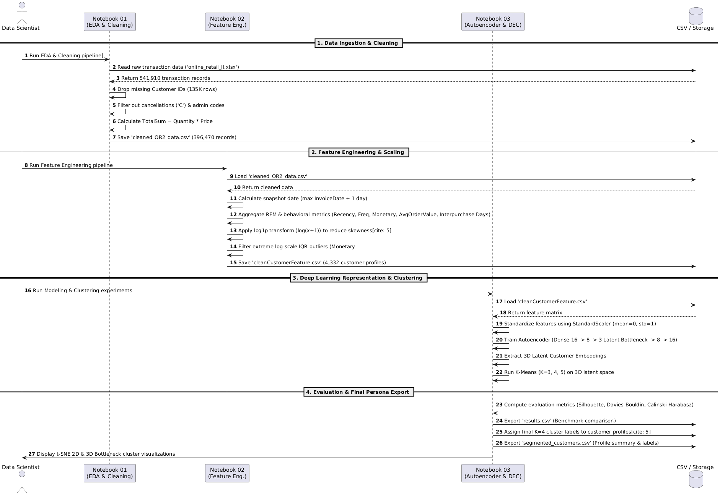
Sequence Diagram

Slide 21
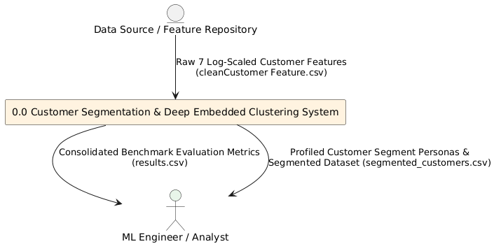
DFD level 0

Slide 22
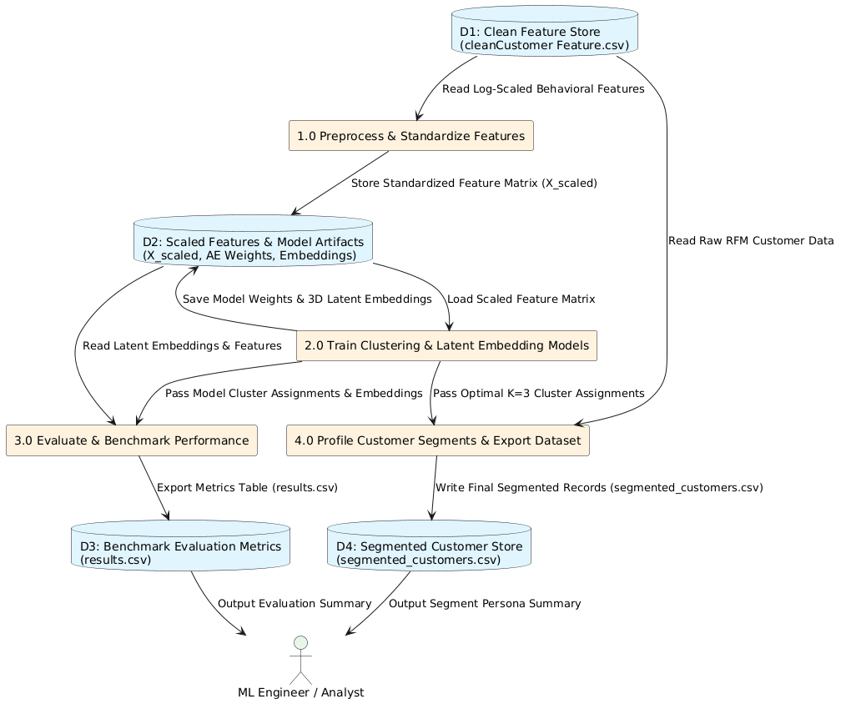
DFD level 1

Slide 23
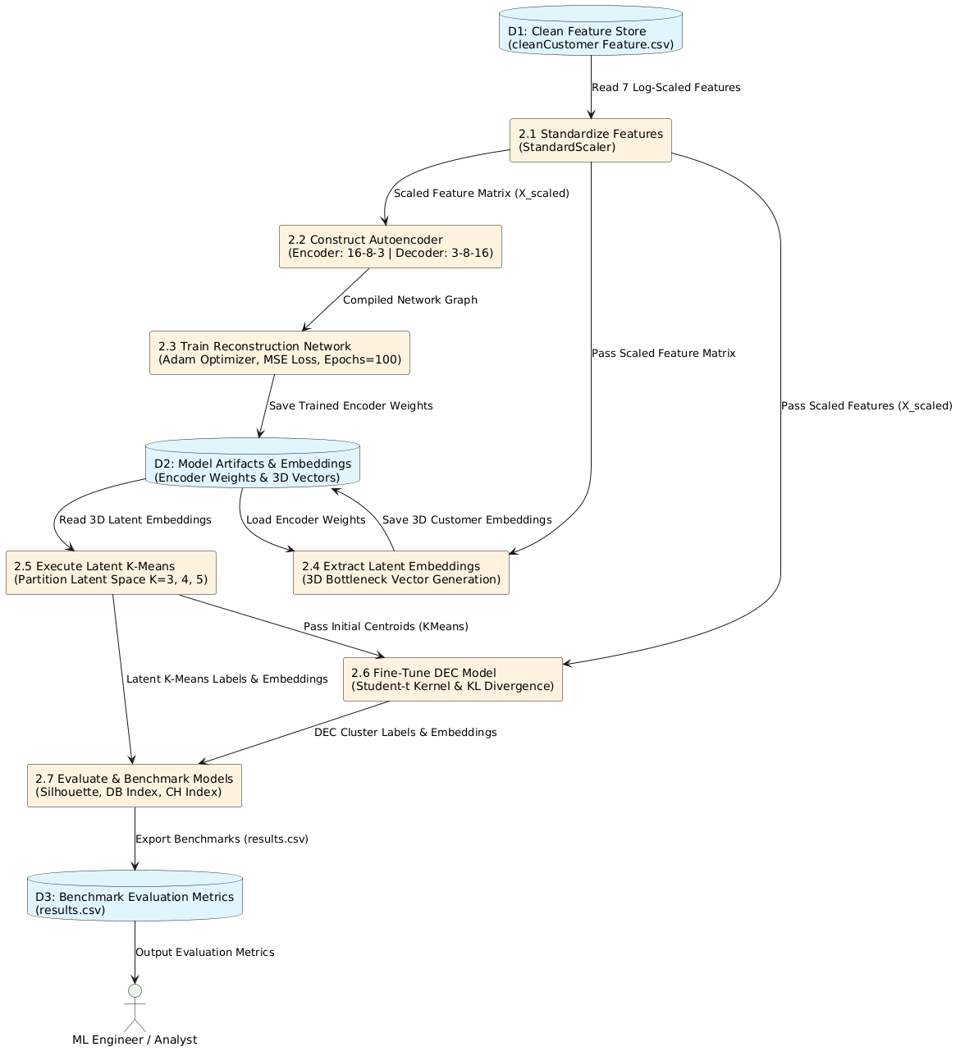
DFD level 2

Slide 24
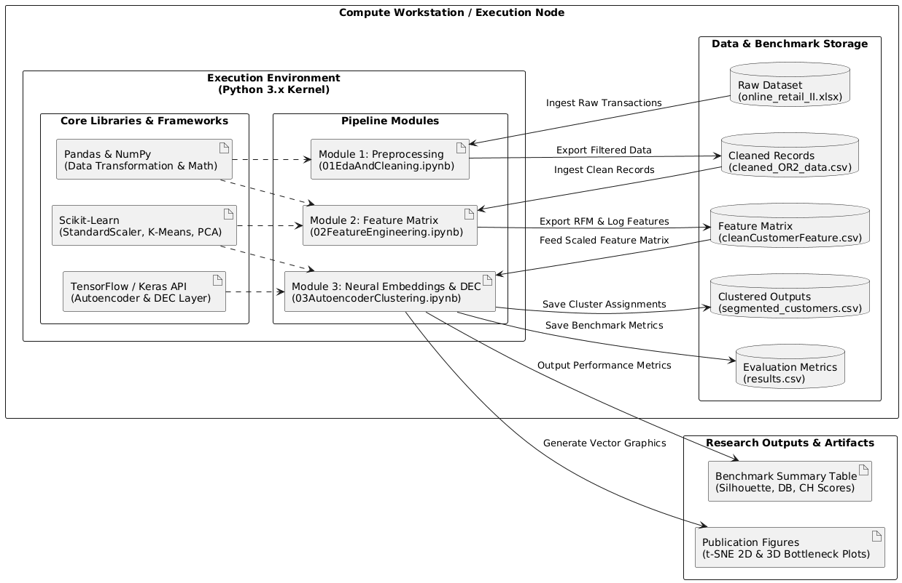
Deployment Diagram

Slide 25
Algorithm
Autoencoder Feature Extraction and Latent K-Means Clustering
Input: X_scaled: Scaled input feature matrix of shape (n_samples, input_dim).
Output: results_df: DataFrame containing clustering evaluation metrics for k ∈ {3, 4, 5}.
Data: input_dim: Number of features in X_scaled; latent_dim: Compressed bottleneck size (3); embeddings: Extracted 3D latent representations; results_list: Storage list for evaluation metrics.
1. Function train_autoencoder_and_cluster(X_scaled):
2. input_dim ← Number of columns in X_scaled
3. latent_dim ← 3
4. encoder ← Construct model: Input → Dense(16, ReLU) → Batch Normalization → Dense(8, ReLU) → Dense(latent_dim, linear)
5. decoder ← Construct model: Input(latent_dim) → Dense(8, ReLU) → Dense(16, ReLU) → Dense(input_dim, linear)
6. autoencoder ← Assemble combined model: Decoder(Encoder(Input))
7. Compile autoencoder using the Adam optimizer (learning rate = 0.001) and mean squared error (MSE) loss
8. Train autoencoder on (X_scaled, X_scaled) for 100 epochs, with batch size 32 and a 15% validation split
9. embeddings ← Extract latent representations using the trained encoder on X_scaled
10. results_list ← []
11. for each k in {3, 4, 5} do
12. kmeans_ae ← Initialize KMeans(n_clusters = k, random_state = 42, n_init = 10)
13. labels_ae ← Fit KMeans and predict cluster assignments on embeddings
14. res ← Evaluate clustering performance metrics using (embeddings, labels_ae)
15. Append res to results_list
16. return Convert results_list to a Pandas DataFrame
.

Slide 26

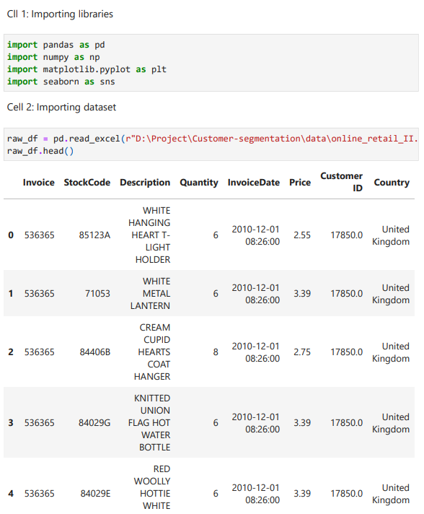
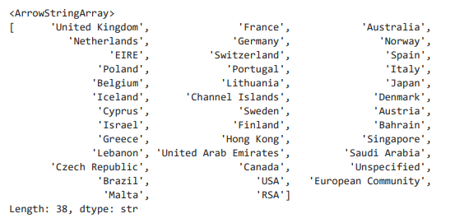
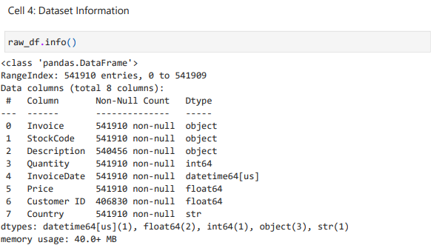
Code & Output
01EdaAndCleaning.ipynb

Slide 27
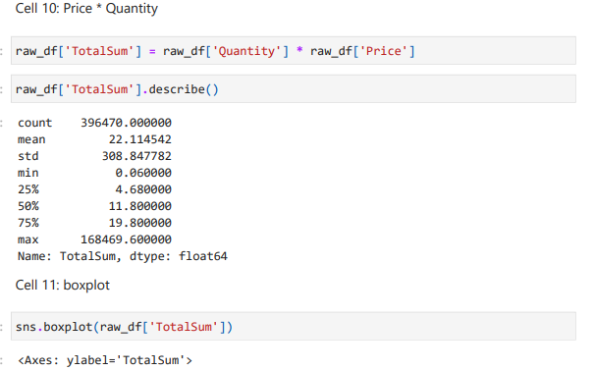
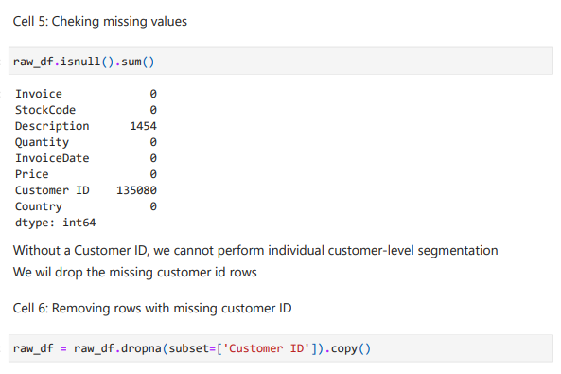
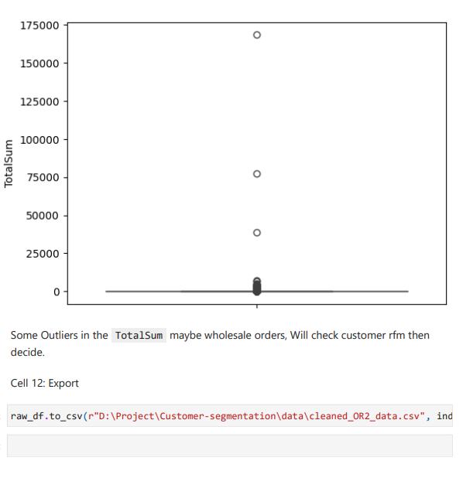
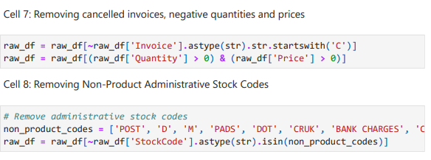

Code & Output
01EdaAndCleaning.ipynb

Slide 28
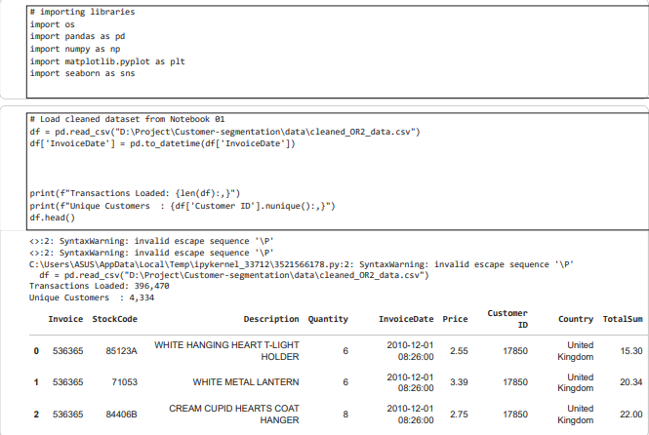
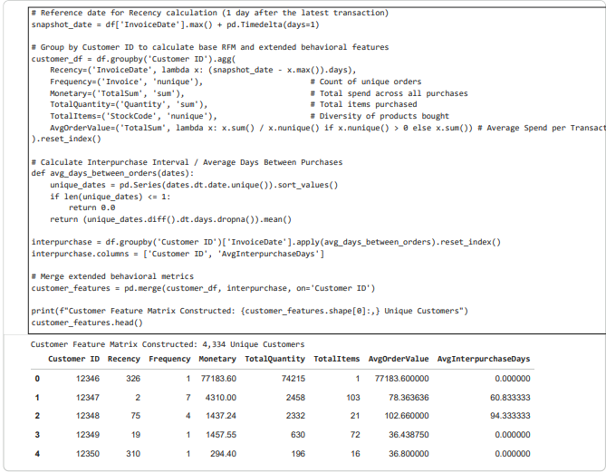
Code & Output
02FeatureEngineering.ipynb

Slide 29
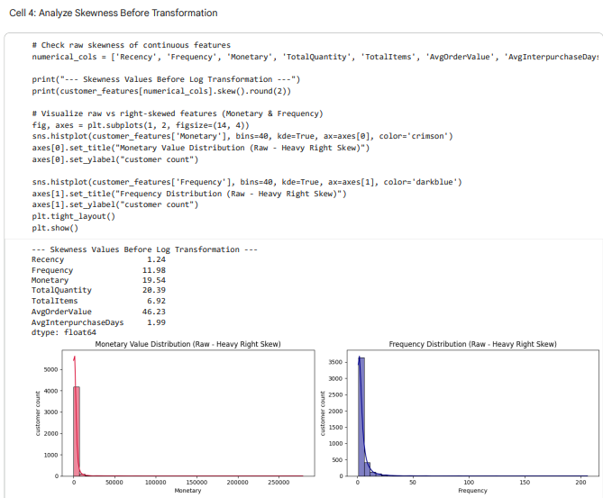
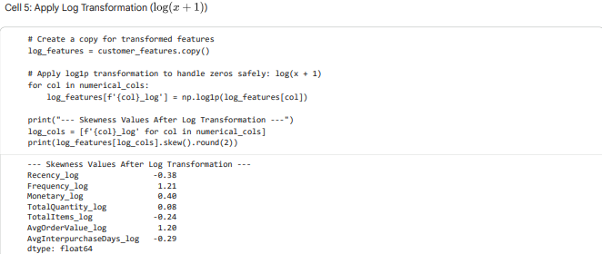

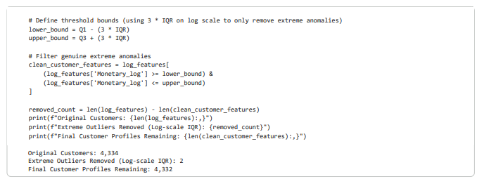
Code & Output
02FeatureEngineering.ipynb

Slide 30
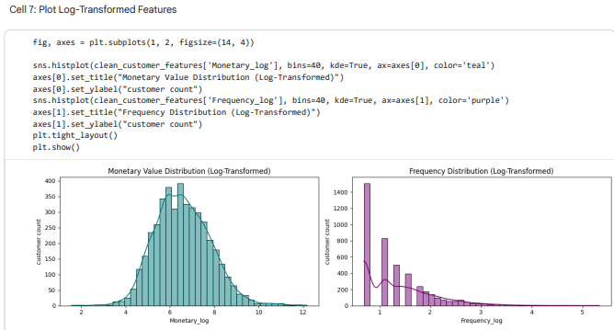
Code & Output
02FeatureEngineering.ipynb

Slide 31
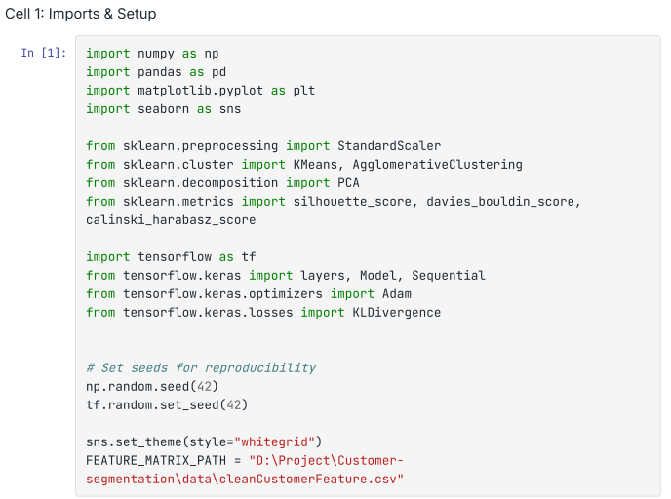
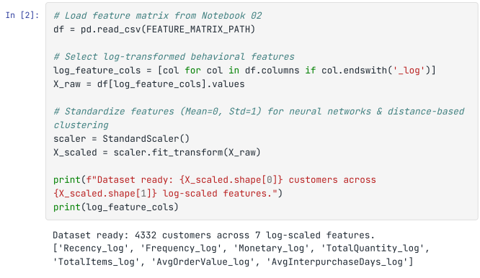
Code & Output
03AutoencoderClusteringExperiments.ipynb

Slide 32
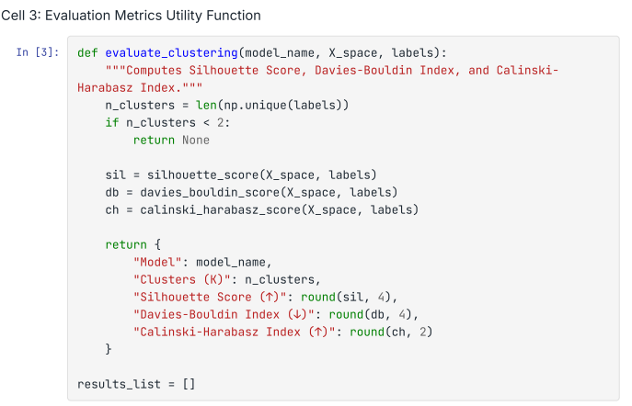
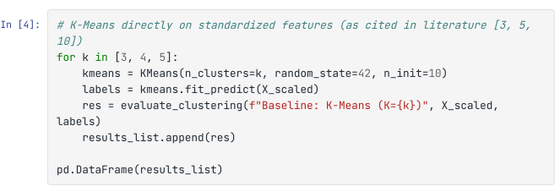
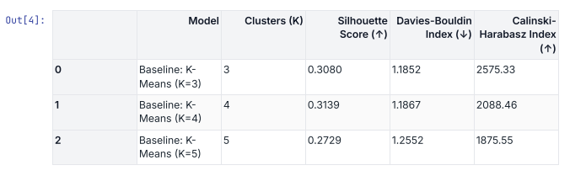
Code & Output
03AutoencoderClusteringExperiments.ipynb

Slide 33
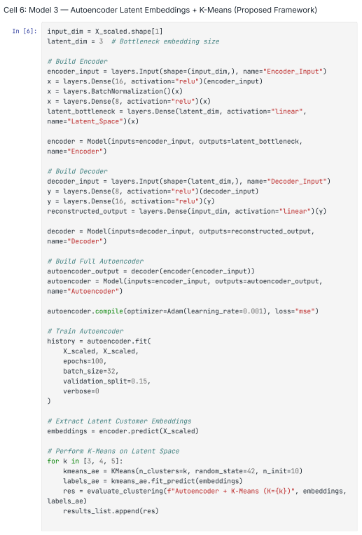
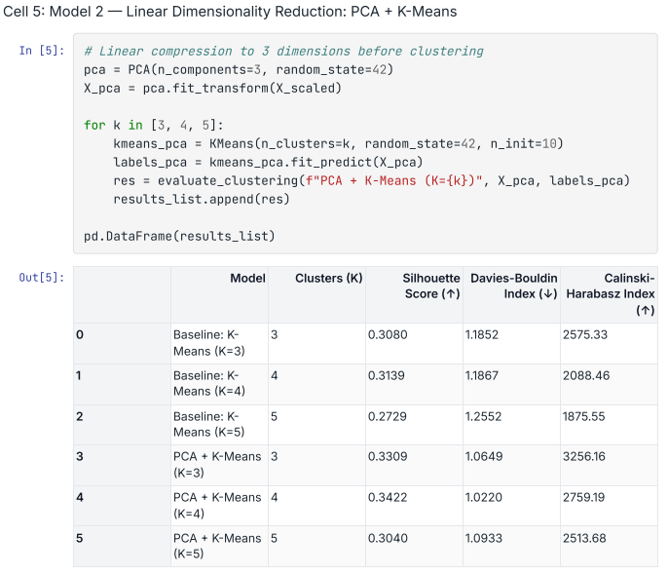
Code & Output
03AutoencoderClusteringExperiments.ipynb

Slide 34
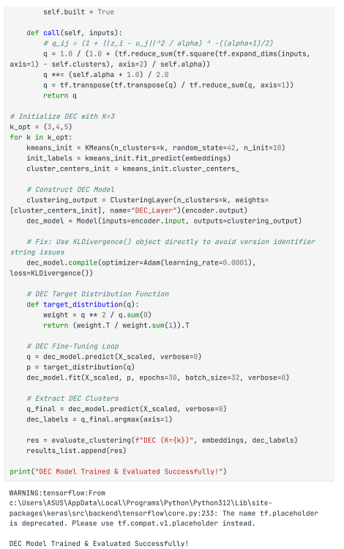
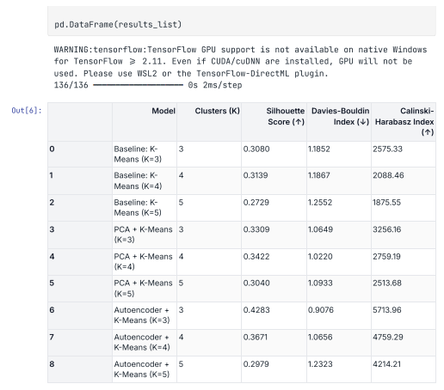
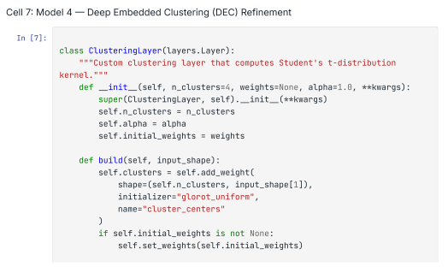
Code & Output
03AutoencoderClusteringExperiments.ipynb

Slide 35
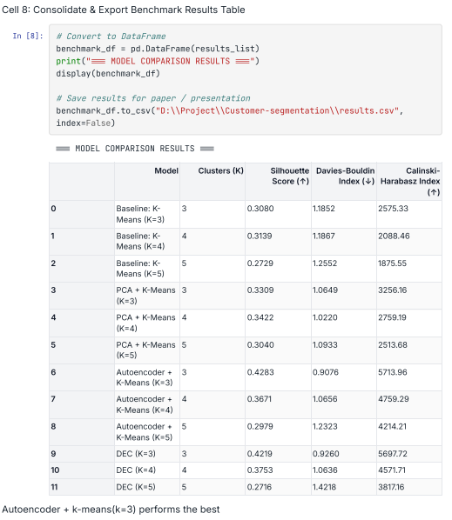
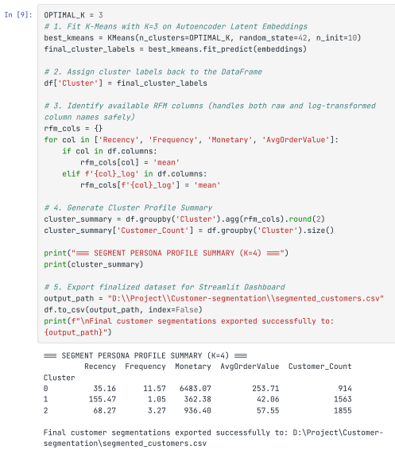
Code & Output
03AutoencoderClusteringExperiments.ipynb

Slide 36
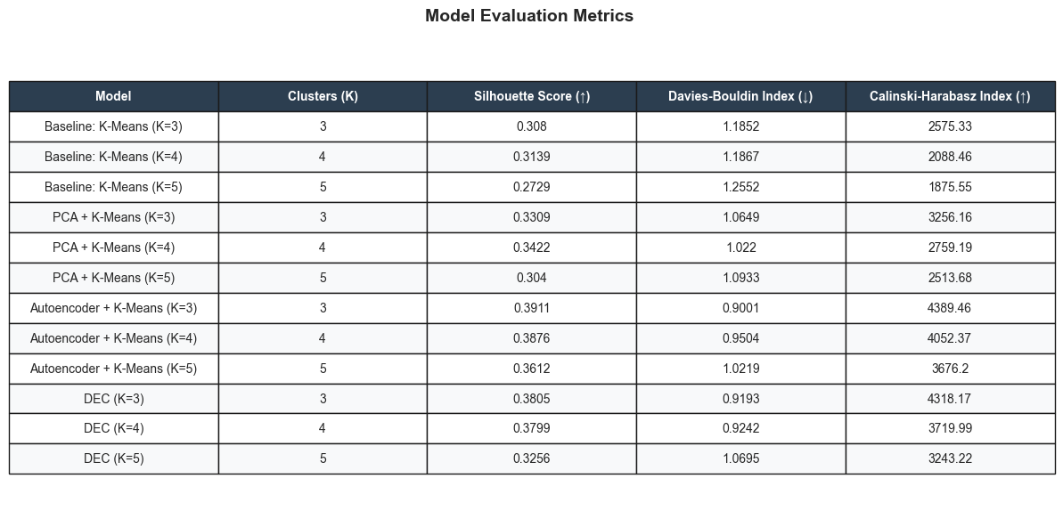
Results
Autoencoder + K-Means (K=3) Achieves Peak Performance
SILHOUETTE SCORE: 0.4382 DAVIES-BOULDIN INDEX: 0.8588 CALINSKI-HARABASZ: 5111.64

Slide 37
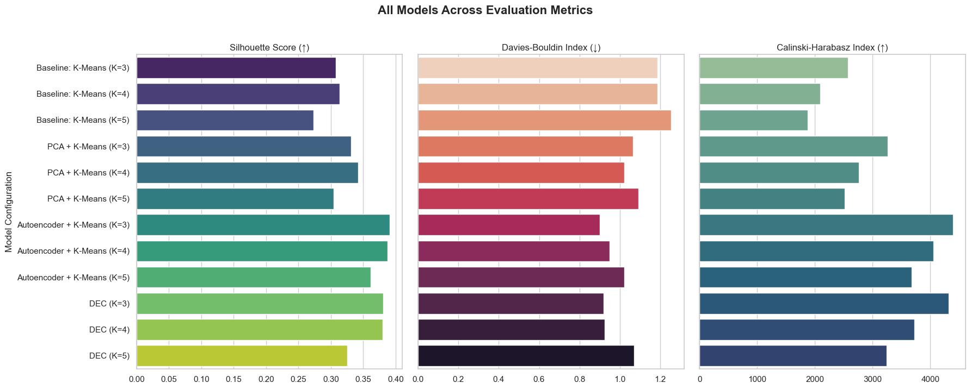
Results

Slide 38
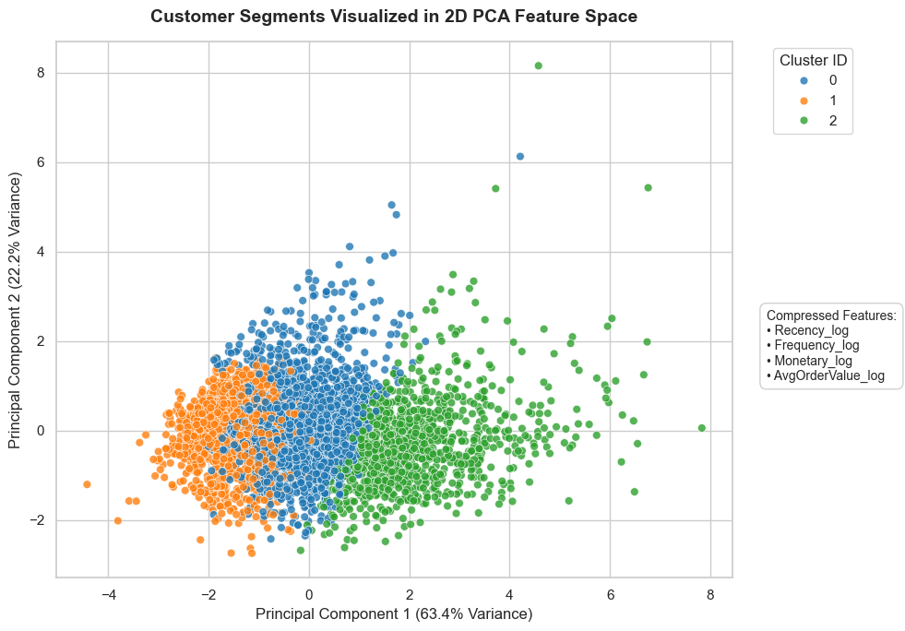
Results

Slide 39
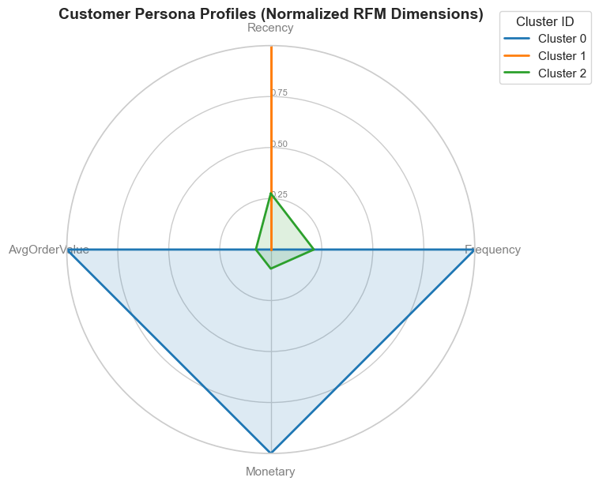
Results

Slide 40
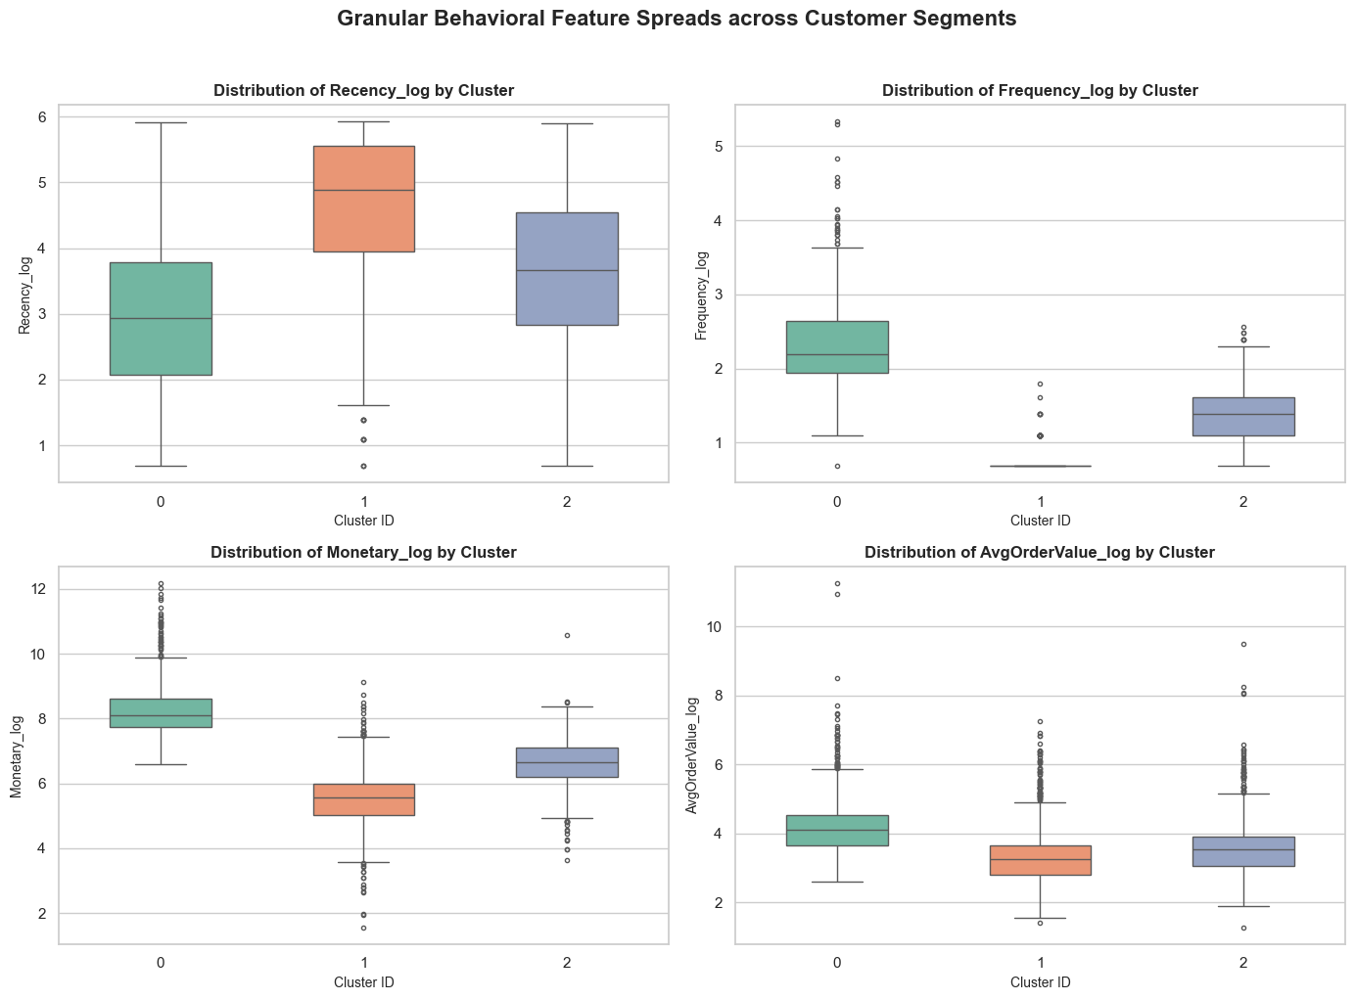
Results

Slide 41
References
[1Xie, J., Girshick, R. &amp; Farhadi, A.. (2016). Unsupervised Deep Embedding for Clustering Analysis. Proceedings of The 33rd International Conference on Machine Learning, in Proceedings of Machine Learning Research 48:478-487 Available from https://proceedings.mlr.press/v48/xieb16.html.
[2] Guo, X., Gao, L., Liu, X., & Yin, J. (2017). Improved Deep Embedded Clustering with Local Structure Preservation. Proceedings of the Twenty-Sixth International Joint Conference on Artificial Intelligence, IJCAI-17, 1753–1759. doi:10.24963/ijcai.2017/243
[3] Palakshappa, Anitha & Patil, Malini. (2019). RFM model for Customer Purchase Behavior using K-Means Algorithm. Journal of King Saud University - Computer and Information Sciences. 34. 10.1016/j.jksuci.2019.12.011.
[4] L. Rajput and S. N. Singh, "Customer Segmentation of E-commerce data using K-means Clustering Algorithm," 2023 13th International Conference on Cloud Computing, Data Science & Engineering (Confluence), Noida, India, 2023, pp. 658-664, doi: 10.1109/Confluence56041.2023.10048834.
[5] L. Rajput and S. N. Singh, “Customer Segmentation of E-commerce data using K-means Clustering Algorithm,” 2023 13th International Conference on Cloud Computing, Data Science & Engineering (Confluence), 2023.
[6] Mehta, D., & Sehgal, S. (2024). A Study on Micro-Segmentation of Retail Customers Using K-Means Clustering. Journal of Business Thought, 15, 75–87. https://doi.org/10.18311/jbt/2024/44468

Slide 42
References
[7] Pai, PY., Lin, SW. & Lu, WM. Integration of association rule mining and RFM analysis with machine learning for e-commerce customer value segmentation: a sustainable retail perspective. Qual Quant 60, 87–125 (2026). https://doi.org/10.1007/s11135-025-02259-8
[8] Wang, M., Meng, T., Gu, X., Wang, D., Wang, R., & Zhao, R. (2025). Deep segmentation of retail customers based on improved DEC and multimodal semantic representation. Alexandria Engineering Journal, 130, 1–10. doi:10.1016/j.aej.2025.09.012
[9 Kijwattanaphokin, S., & Lhaochot, L. (2026). Customer segmentation using a hybrid approach of K-Means clustering and RFM: An online retail case study. Journal of Logistics and Supply Chain Operations, 12(2). https://doi.org/10.53848/jlsco.v12i2.299053
[10] Skha Yusfa, M. N., Musyawwa, A., & Pratama, A. B. (2026). Customer Segmentation Using the K-Means Algorithm for Customer Intelligence and Marketing Strategy in an Online Retail Company (Case Study: Online Retail Dataset II). Journal of Information Systems and Business Technology, 2(3), 427-432. https://journal.jci.co.id/jisbt/article/view/473
[11] Rahadian, Y. R., Handayani, D., Firia Ferlania, D. A., Rusindiyanto, Rakhmanhuda, I., Pradanarka, A. M., & Indraswari, R. (2026). Customer segmentation based on RFM, deep embedded clustering, and lifetime value analysis for loyalty strategy optimization. Procedia Computer Science, 284, 1611–1618. doi:10.1016/j.procs.2026.07.154
[12] Manikandan, R. S., Sundar, S. K., Amalraj, J. J., Selvam, P., & Faheem, M. (2026). Deep learning-driven customer segmentation model for online retail industry based on extended RFM model. Discover Computing, 29(1), Article 507. https://doi.org/10.1007/s10791-026-10421-5

Slide 43
Thank You

